Slide 1


Syeda Sarah Mashhood
20th July 2023

Slide 2

Outline
Executive Summary
Introduction
Methodology
Results
Conclusion
Appendix

Slide 3
Executive Summary
In order to determine successful landing of SpaceX Falcon 9 rocket launches, a prediction model has been deployed. For the purpose, data has ben collected via API and web scrapping, then data wrangling an cleaning have been performed. Exploratory data analysis has been performed to gather insights from the data. Then data has been split into train and test data. Various ML classifier model have been applied with hyper parameter tuning and best model i.e. Decision Tree has been selected with accuracy of 89%.

Slide 4
Introduction
SpaceX advertises Falcon 9 rocket launches on its website with a cost of 62 million dollars; other providers cost upward of 165 million dollars each, much of the savings is because SpaceX can reuse the first stage. Therefore if we can determine if the first stage will land, we can determine the cost of a launch. This information can be used if an alternate company wants to bid against SpaceX for a rocket launch.
In this project, we will predict if the Falcon 9 first stage will land successfully.

Slide 5

Section 1

Slide 6
Methodology
Data collection methodology:
The data has been collected using SpaceX API and Web scrapping
Perform data wrangling
The collected data has been explored to find out the patterns, cleaning of labels and catering null values
Perform exploratory data analysis (EDA) using visualization and SQL
Perform interactive visual analytics using Folium and Plotly Dash
Perform predictive analysis using classification models
Machine learning pipeline has been created with different classification models and checked the accuracy and confusion matrix to select the best fit model

Slide 7
Data Collection
Data has been collected by two means:
Using SpaceX REST API
Using Web scrapping

Slide 8
Data Collection – SpaceX API
Rocket launch data collected from SpaceX API has a lot of information thus static URL has been used to get the response from API. Further functions have been called to get the desired data from within the response
URL for code and output:
https://github.com/Sarah-Mashhood/Data_Science_Capstone_IBM/blob/master/jupyter-labs-spacex-data-collection-api.ipynb
Request for Data using API
Parse and Get Data
Clean Data and Extract Falcon 9 records

Slide 9
Data Collection - Scraping
Request the data of Falcon9 Launch from Wiki page using BeautifulSoup. Required HTML table has been extracted and data from columns and rows have been fetched and stored in pandas Dataframe.
URL for code and output:
https://github.com/Sarah-Mashhood/Data_Science_Capstone_IBM/blob/master/jupyter-labs-webscraping.ipynb
Request WikiPage using URL
Extract all columns from HTML table
Parse HTML table and create a Dataframe

Slide 10
Data Wrangling
Collected data has been processed using python programming.
Null values has been checked and filled using mean values.
Data types of columns has been corrected.
Data has been explored to see the unique values in the columns.
Here is the URL for code and output:
https://github.com/Sarah-Mashhood/Data_Science_Capstone_IBM/blob/master/labs-jupyter-spacex-data_wrangling_jupyterlite.jupyterlite.ipynb

Slide 11
EDA with Data Visualization
EDA has been done by plotting different visualization.
Scatter plots have been made for checking relationship for Flight No. Vs other variables like Orbit, Launch Site, PayLoad Mass.
Scatter Plots of Orbit and Launch Site have also been visualized against Payload Mass.
Success Rate has been observed over the period of time and for different Orbits.
Here is the URL describing code and output:
https://github.com/Sarah-Mashhood/Data_Science_Capstone_IBM/blob/master/jupyter-labs-eda-dataviz.ipynb.jupyterlite.ipynb

Slide 12
EDA with SQL
Different SQL queries have been run on data to get information like unique launch sites, total payload mass carried by boosters launched by NASA (CRS), first successful landing outcome in ground pad, successful boosters in drone ship, total number of successful and failure mission outcomes etc.
Here is the URL describing code and output:
https://github.com/Sarah-Mashhood/Data_Science_Capstone_IBM/blob/master/jupyter-labs-eda-sql-coursera_sqllite.ipynb

Slide 13
Build an Interactive Map with Folium
NASA Space Center has been circled and marked along with all launch sites on a map. Moreover, success/failed launches have been marked using color coding for each site on the map
The distances between a launch site to its proximities (like costal lines, railways, cities and highways etc.)
Here is the URL describing code and output:
https://github.com/Sarah-Mashhood/Data_Science_Capstone_IBM/blob/master/lab_jupyter_launch_site_location.jupyterlite.ipynb

Slide 14
Build a Dashboard with Plotly Dash
In Plotly Dashboard, pie chart has been made to show the contribution of each launch site in successful launching. Then, another interactive plot has been made to show correlation between the payload and successful launches.
Here is the URL describing code and output:
https://github.com/Sarah-Mashhood/Data_Science_Capstone_IBM/blob/master/spacex_dash_app.py

Slide 15
Predictive Analysis (Classification)
Different Classification Machine Learning algorithms (Logistic Regression, SVM, Tree, KNN) have been deployed with Hyper parameter tuning to find out the best parameters on train dataset and then best model has been selected by calculating accuracy and visualizing confusion matrix.
Here is the URL describing code and output:
https://github.com/Sarah-Mashhood/Data_Science_Capstone_IBM/blob/master/SpaceX_Machine_Learning_Prediction_Part_5.jupyterlite.ipynb

Slide 16
Results
EDA shows that launch site CCAFS LC-40, has a success rate of 60 %, while KSC LC-39A and VAFB SLC 4E has a success rate of 77%.
For the VAFB-SLC launch site there are no rockets launched for heavy payload mass(greater than 10000).
In the LEO orbit the Success appears related to the number of flights.
There seems to be no relationship between flight number when in GTO orbit.
ES-L1, GEO, HEO, SSO orbits have high success rate.
With heavy payloads the successful landing rate are more for Polar, LEO and ISS Orbits. For GTO, It can’t be distinguished.
EDA shows that the success rate since 2013 kept increasing till 2020.
The first successful landing outcome in ground pad was achieved in 2015.

Slide 17
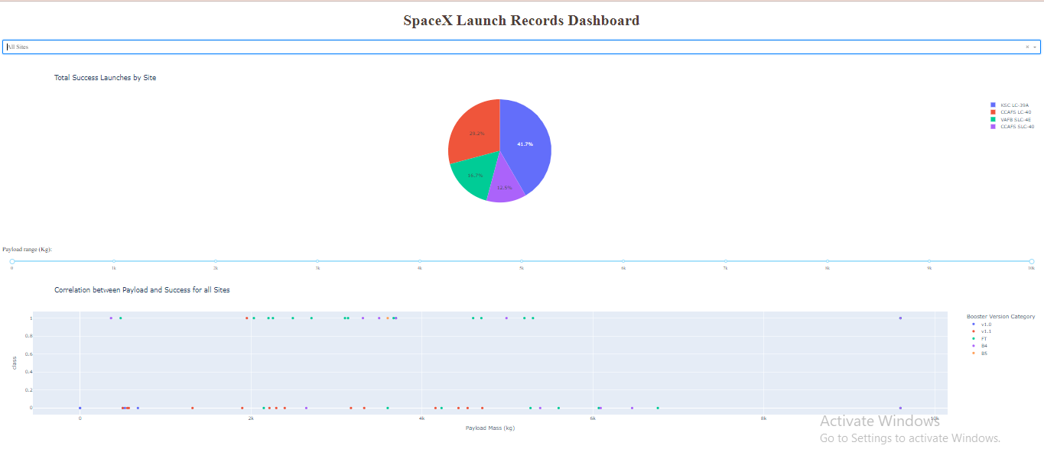
Results

Slide 18
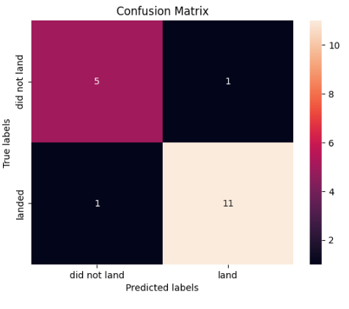
Results
The best ML model is Decision Tree classifier with parameters of {'criterion': 'entropy', 'max_depth': 4, 'max_features': 'auto', 'min_samples_leaf': 2, 'min_samples_split': 2, 'splitter': 'random'} and having accuracy of approx. 89%

Slide 19

Section 2

Slide 20
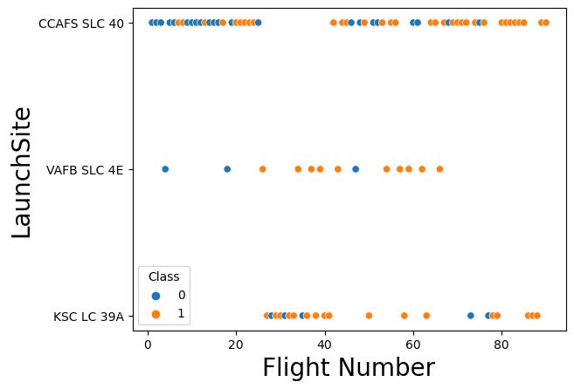
Flight Number vs. Launch Site
This is a scatter plot of Flight Number vs. Launch Site.
It shows successful and unsuccessful landing for different launch site with respect to Flight Numbers.

Slide 21
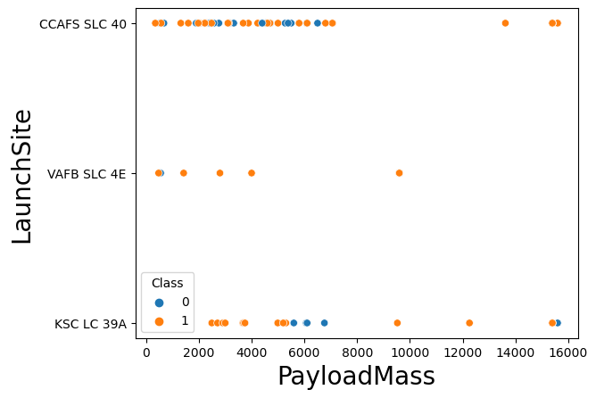
Payload vs. Launch Site
This is a scatter plot of Payload vs. Launch Site
It shows successful and unsuccessful landing for different launch site with respect to PayLoad Mass.
For the VAFB-SLC launchsite there are no rockets launched for heavypayload mass(greater than 10000).

Slide 22
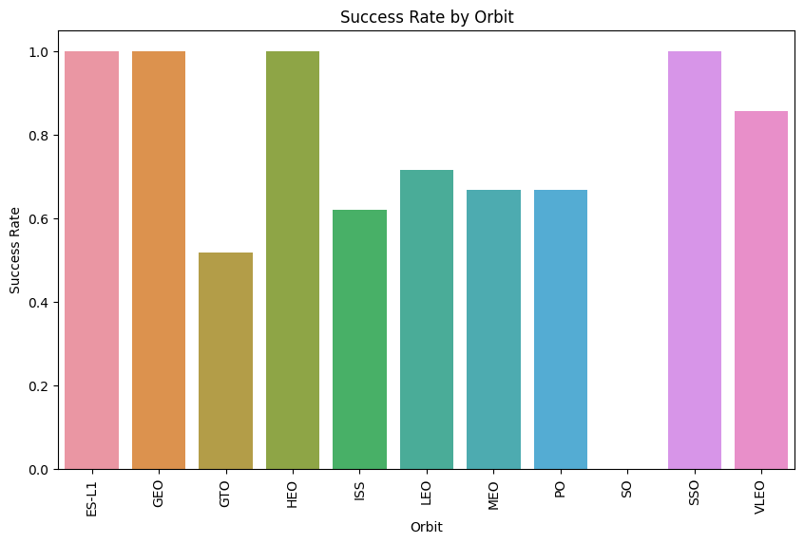
Success Rate vs. Orbit Type
This bar chart shows the success rate of each orbit type
ES-L1, GEO, HEO and SSO orbits have high success rate.

Slide 23
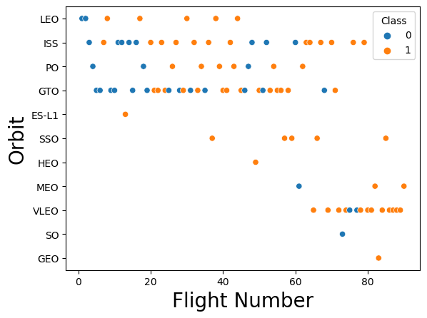
Flight Number vs. Orbit Type
This scatter plot shows the Flight number vs. Orbit type
It can be seen that GEO, SSO, ES-L1 and HEO are successful irrespective of Flight No.

Slide 24
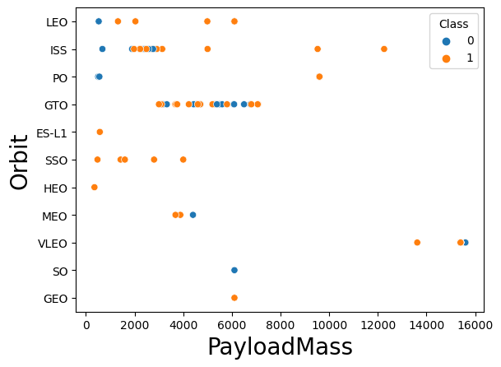
Payload vs. Orbit Type
This is a scatter plot of payload vs. orbit type
We can see the success outcomes for different Orbit in respect of different Payload Masses.
Almost all the orbits except VLEO, ISS and PO don’t use for Payload Mass greater than 8000kg

Slide 25
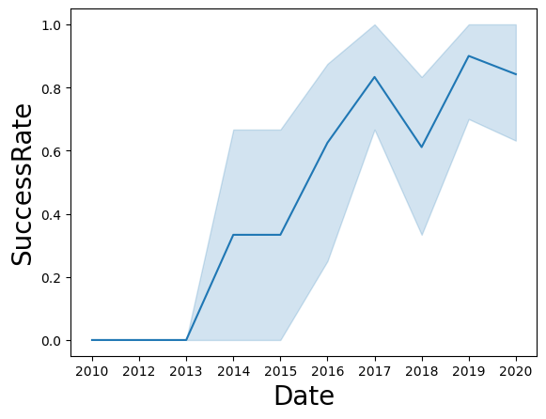
Launch Success Yearly Trend
This line chart shows yearly average success rate
It can be seen that the success rate since 2013 kept increasing till 2020

Slide 26
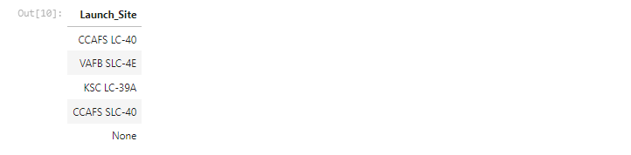
All Launch Site Names
Here are the names of all the launch sites.

Slide 27
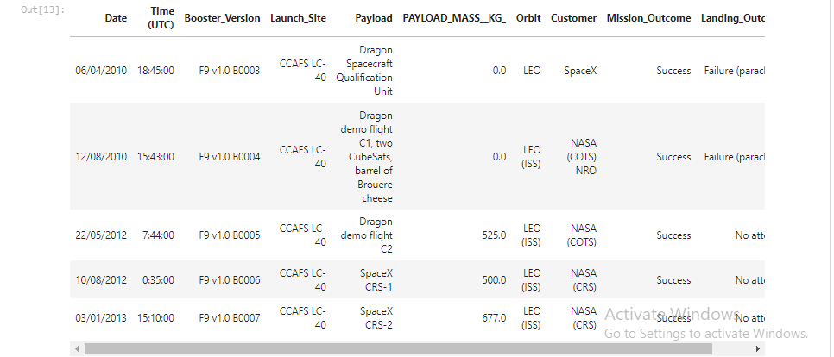
Launch Site Names Begin with 'CCA'
These are the 5 records where launch sites begin with `CCA`

Slide 28
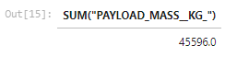
Total Payload Mass
The total payload carried by boosters from NASA id 45596 Kg

Slide 29
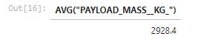
Average Payload Mass by F9 v1.1
The average payload mass carried by booster version F9 v1.1 is 2928.4Kg

Slide 30

First Successful Ground Landing Date
The first successful landing outcome on ground pad is on 22nd December 2015

Slide 31
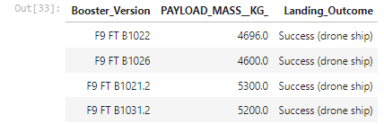
Successful Drone Ship Landing with Payload between 4000 and 6000
Here is the list of the names of boosters which have successfully landed on drone ship and had payload mass greater than 4000 but less than 6000

Slide 32
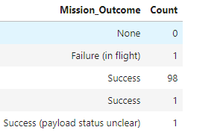
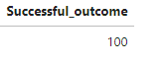
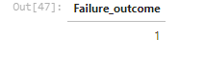
Total Number of Successful and Failure Mission Outcomes
Here are the total number of successful and failure mission outcomes

Slide 33
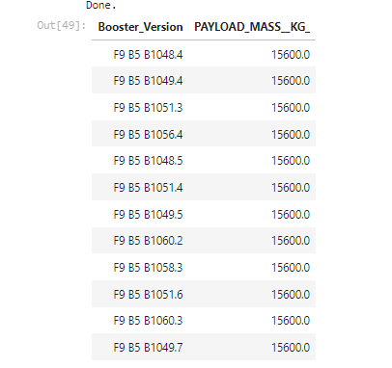
Boosters Carried Maximum Payload
Here is the list of the names of the booster which have carried the maximum payload mass

Slide 34
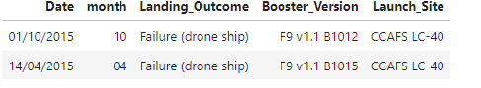
2015 Launch Records
List the failed landing_outcomes in drone ship, their booster versions, and launch site names for in year 2015

Slide 35
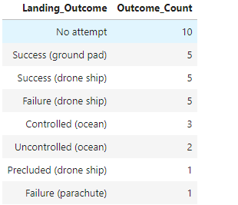
Rank Landing Outcomes Between 2010-06-04 and 2017-03-20
Here is the Ranking for count of landing outcomes (such as Failure (drone ship) or Success (ground pad)) between the date 2010-06-04 and 2017-03-20, in descending order

Slide 36

Section 3

Slide 37
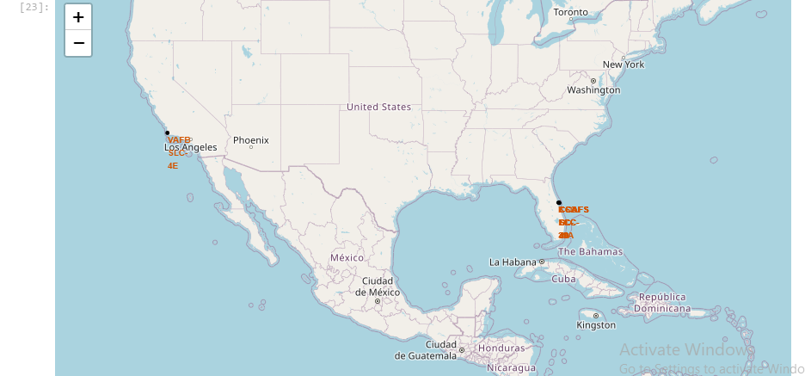
Map for Launch site locations
This map shows the all launch site locations on the global map, site names can be seen too.

Slide 38
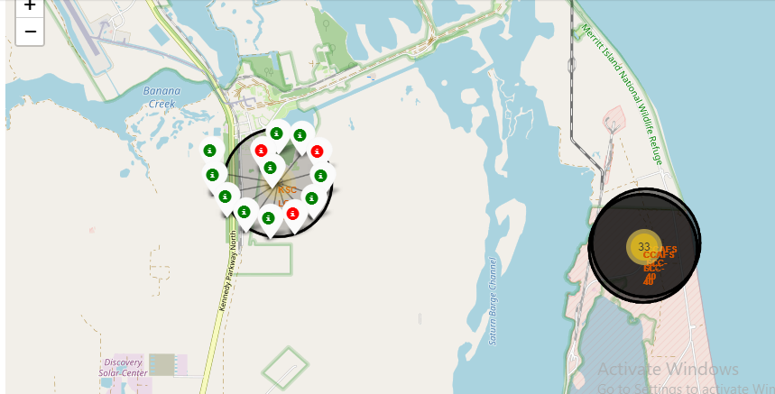
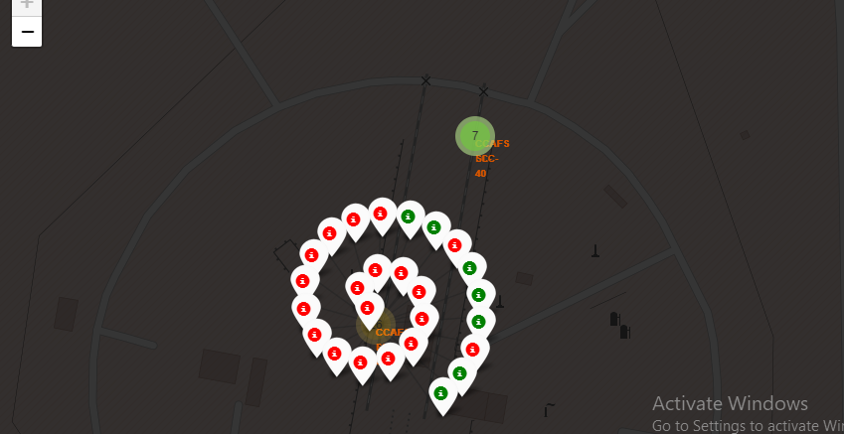
Map for Markers for launch outcomes
The map shows all the successful (Green) and failure (Red) outcomes for all launch sites.

Slide 39
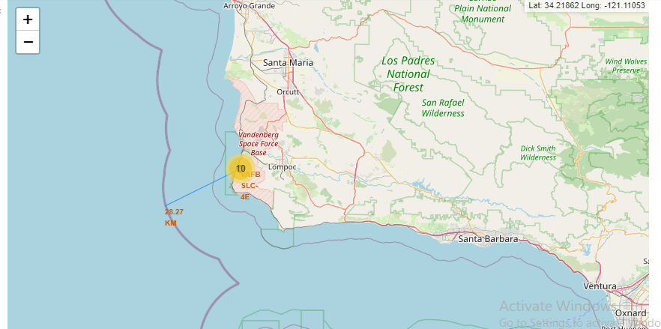
Map shows distance from launch site to its proximities
The below map shows the distance of coastline from launch site VAFB SLC-4E and the distance if approx. 28.27km

Slide 40

Section 4

Slide 41
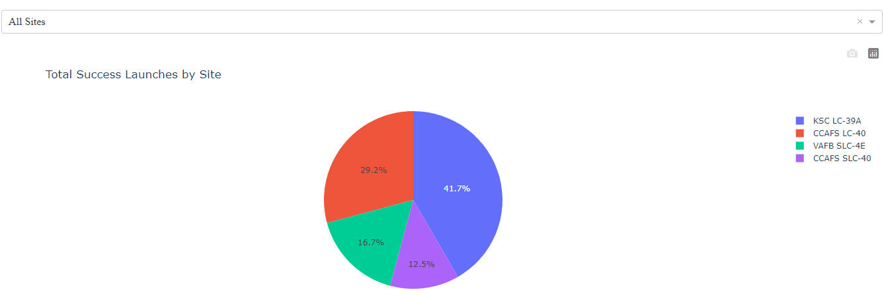
Launch success count for all sites
This pie chart shows the launch success count for all sites.

Slide 42
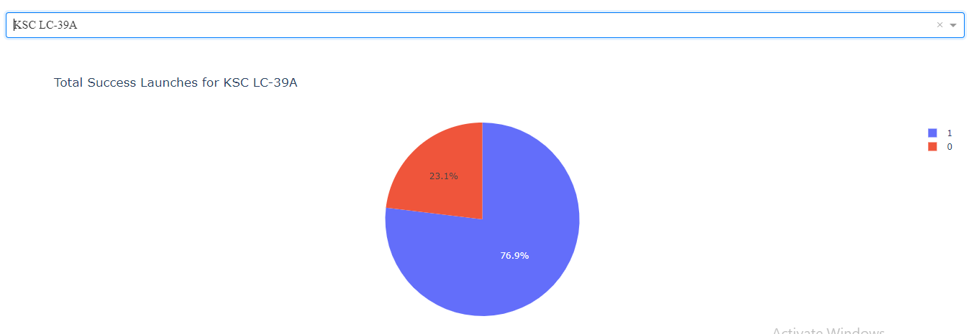
Most successful launches of site KSC LC-39A
It shows the pie chart for the launch site i.e. KSC LC-39A with highest launch success ratio i.e. 76.9%

Slide 43
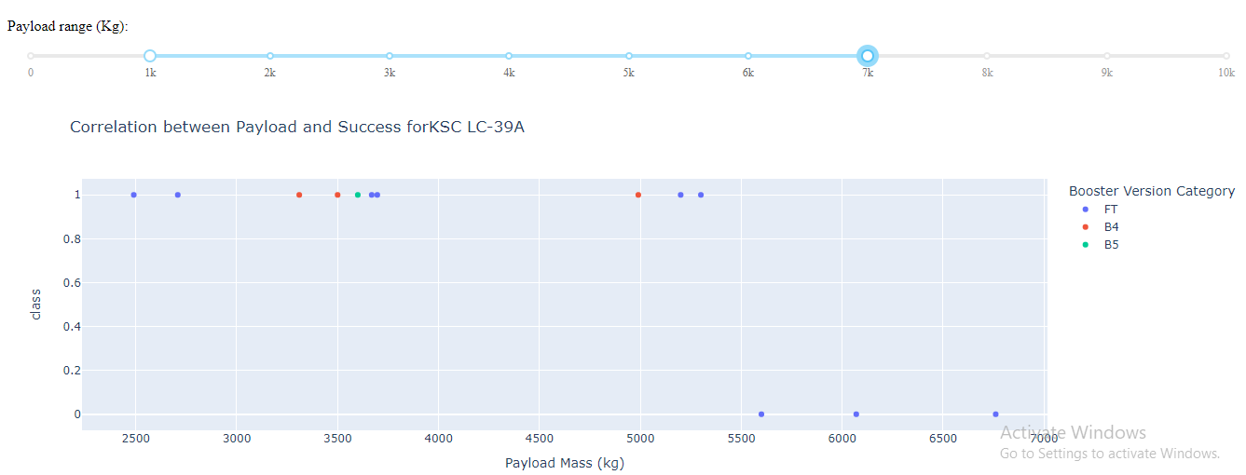
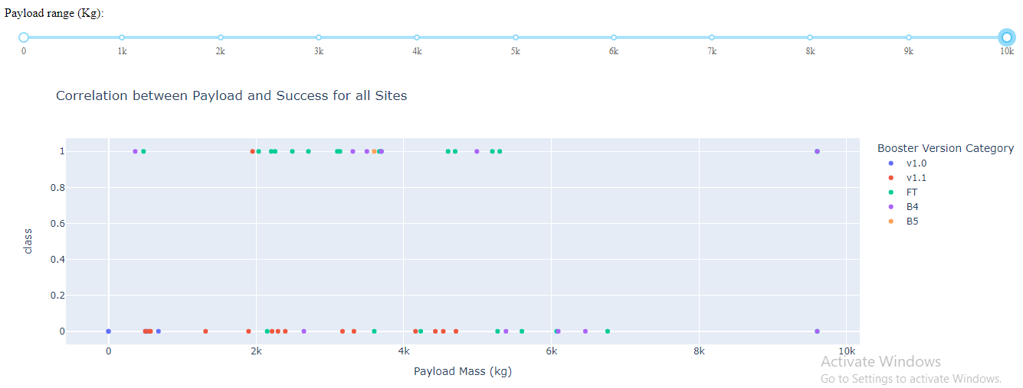
Payload vs. Launch Outcome scatter plot for all sites
These scatter plots shows the Payload vs. Launch Outcome for all sites, with different payload selected in the range slider
It shows that for KSC LC-39A, there is success for payload less than 5500kg.

Slide 44

Section 5

Slide 45
Classification Accuracy
Here is the bar charts which shows accuracy of different ML classifier models
Decision Tree model has the highest classification accuracy i.e. 89%

Slide 46

Confusion Matrix
The confusion matrix of Decision Tree shows below.
There is only one FN and only one FP.
However, all the other predictions are correct.

Slide 47
Conclusions
In order to predict successful landing of launches of Space X Falcon 9 rockets:
Data has been collected, scrapped and wrangled.
EDA has been performed on the data to find out different insights about the launch sites and their successful outcomes, the relation between the outcomes and different variables like Payload Mass, Booster Version, Flight No. and Orbit type.
Folium Maps has been created to visualize the locations of launch sites.
Interactive Dashboard has been created to visualize the successful outcomes by selecting different sites and Payload Masses.
Different ML Classifier models have been implemented and best fit model with best parameters has been finalized which gives best accuracy among all the models.

Slide 48
Appendix
Here is the link of dataset that has been used:
https://github.com/Sarah-Mashhood/Data_Science_Capstone_IBM/blob/master/spacex_launch_dash.csv
Here is the link for project repository:
https://github.com/Sarah-Mashhood/Data_Science_Capstone_IBM/tree/master

Slide 49


